Slide 1
Understanding & Exploiting Common Crypto-Coding Mistakes -1
Ajit Hatti
ajit@pureid.io

Slide 2
Contents
Casual Random Approach
Poor Decisions
Insecure Crypto coding
Parameter Reuse

Slide 3
1. Randomness
+ True Randomness and Pseudo Randomness
+ Where is it used, Why is it important
+ Generation source
+ Case studies

Slide 4
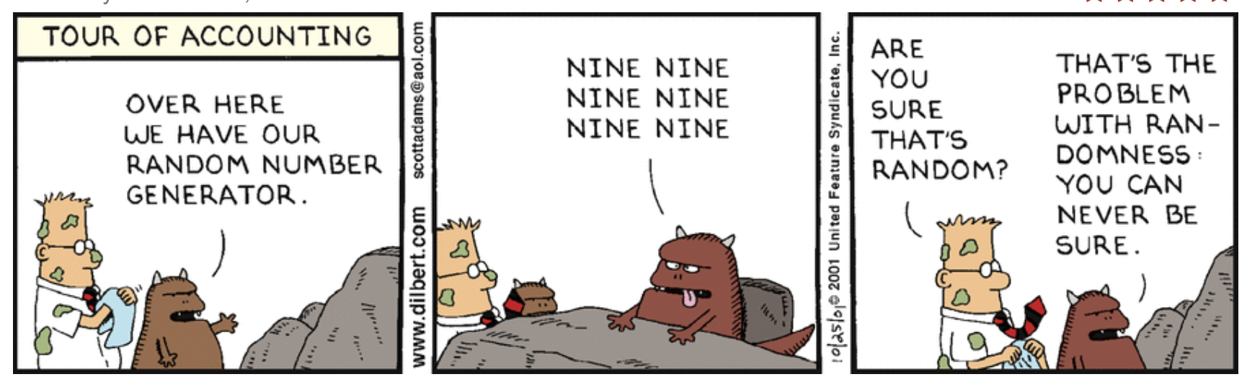
1. Randomness
Which string is randomly generate and which one forged by me?
● 100110101011010101010101010010100110101
● 101011001010101000110001100101110101011
● 010100100110100110010110101011011110100
Lets produce Random Numbers - LAB 1 (lab-1.txt)

Slide 5


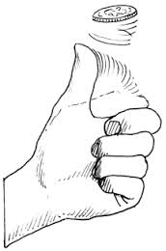
Problem With Random Number Generators
Difficult to find a High quality Random Number
Physically generated by
  radioactive decay,
  thermal noise,
  shot noise, avalanche noise in Zener diodes,
  clock drift
Instead of rand() function use
On Linux/BSD/Mac use: /dev/urandom
On Windows use CryptGenRandom()
In java use: Java.security.SecureRandom()
LAB – 2. (lab-2.txt)

Slide 6
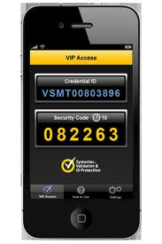
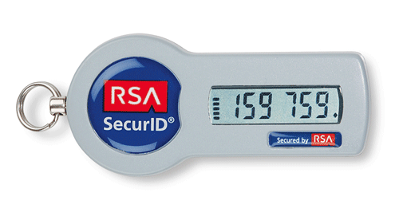
Pseudo Random Numbers (PRNG)
Re-generable Random Number
Generates random number using a SEED value
With same generation function and same SEED, the number generated at 2 different location will be same.
LAB 3 (lab-3.txt)

Slide 7


Security issues
Range :
  The limit within which the random numbers are casted and used
Period :
  The instances after which you and number is repeated
Testing the random ness
  Many mathematical tests
  Visualization Tests
Lab 4 (lab-4.txt)
Lan 5 (lab-5.txt)
LAMMA -RNG
LAMMA – fakeRNG

Slide 8
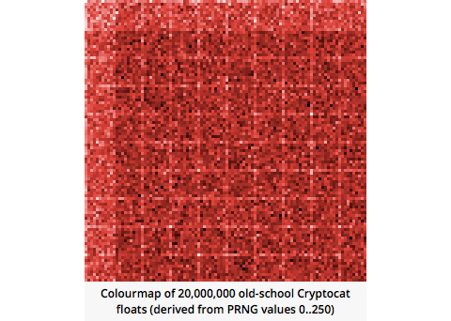
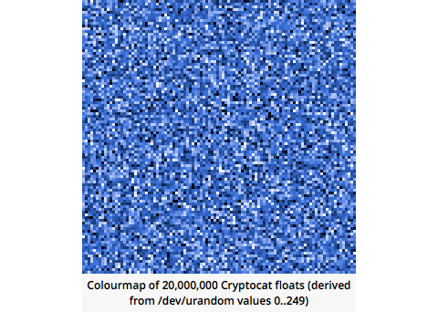


Case Studies
Random Numbers VS Cryptographically Secure Random Numbers
Cryptocat’s RNGs
Random.org
PHP rand() function
Notes:
27/10/18

Slide 9
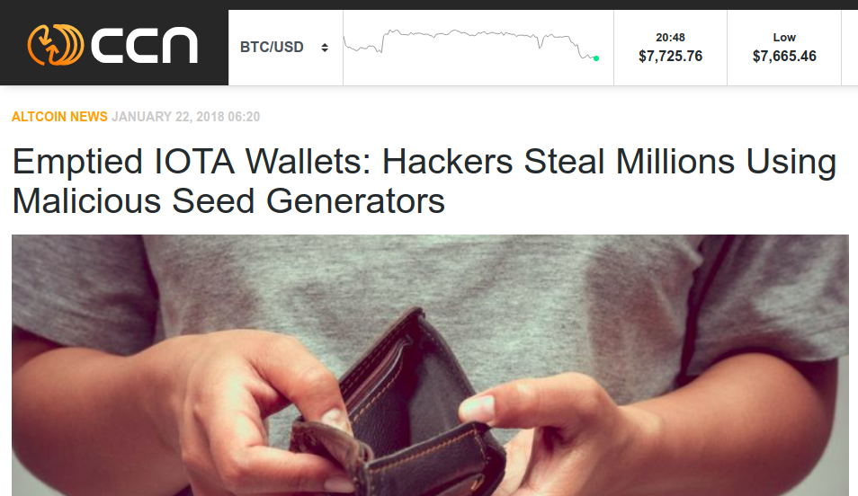
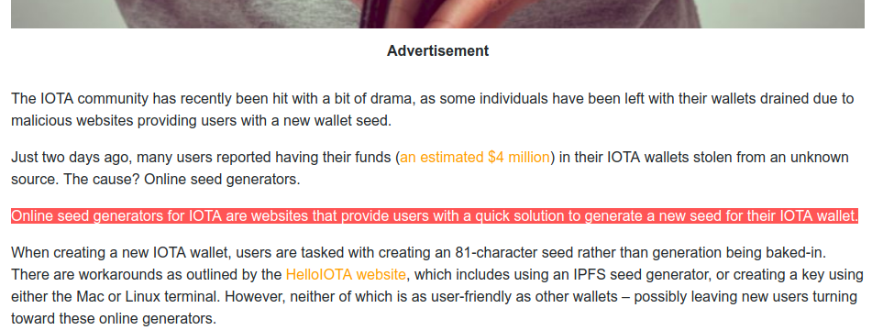
Case Studies : IOTA

Slide 10
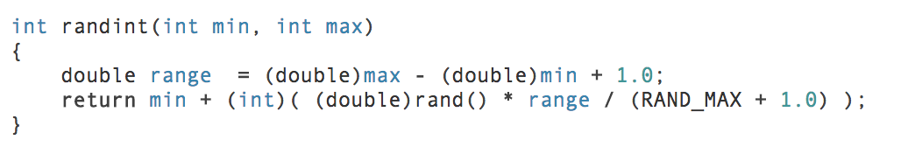
Best Practices for RNG and PRNGs
Use good entropy source to generate random numbers
Don’t use % to define range of RN or PRN, folats can be used.
Handle Integer over/under flows
If possible use Hardware Security Module (HSM) generated RNGs
Use strong ciphers and hashing schemes to write PRNG functions
DO NOT USE KEYS OR SEEDS GENERATED BY THIRD PARTY....

Slide 11
2. Poor Decisions
Copy code from Net
Use default values
Hard coding sensitive Information
Case studies

Slide 12
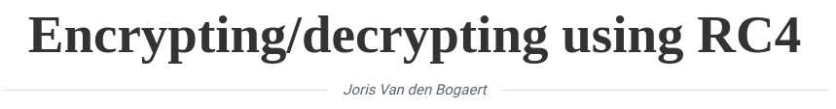
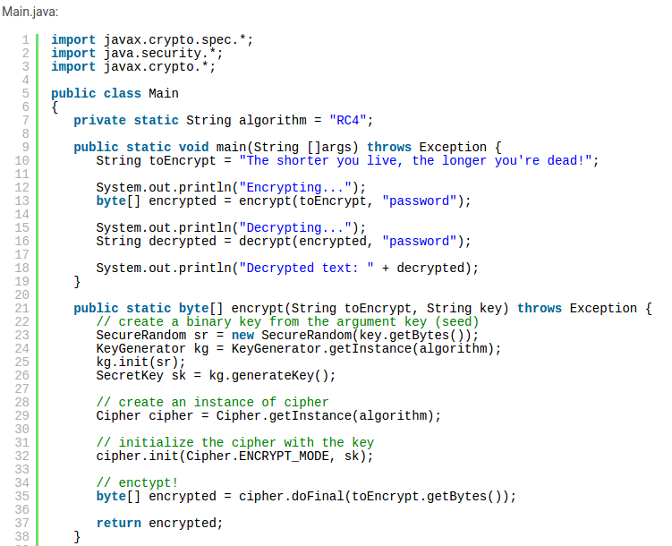
Code from Internet
Notes:
27/10/18

Slide 13
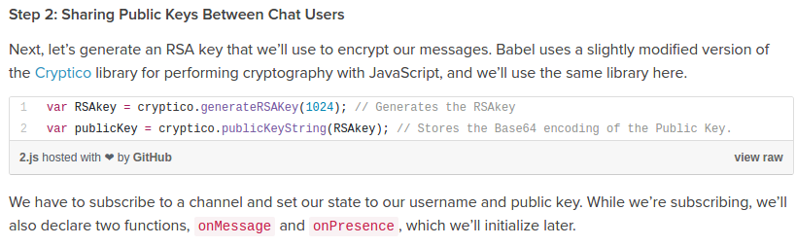
Code from Internet
The Problems :
  A person might be expert in Language but not in Cryptography
  Old code was written with contemporary standards.
Notes:
27/10/18

Slide 14
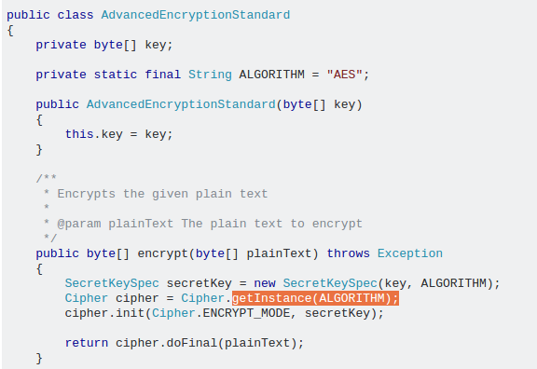
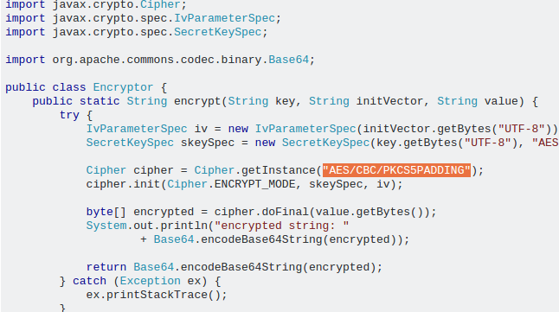
Default Values are not Secure
Notes:
27/10/18

Slide 15
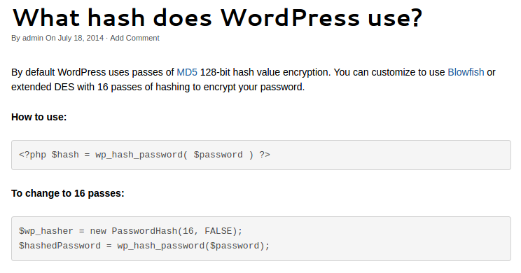
Default Values are not Secure
LAB 6 – Default size of RSA keys
Notes:
27/10/18

Slide 16
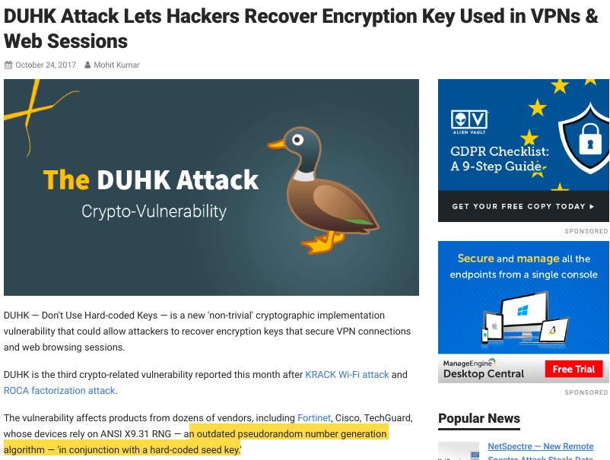
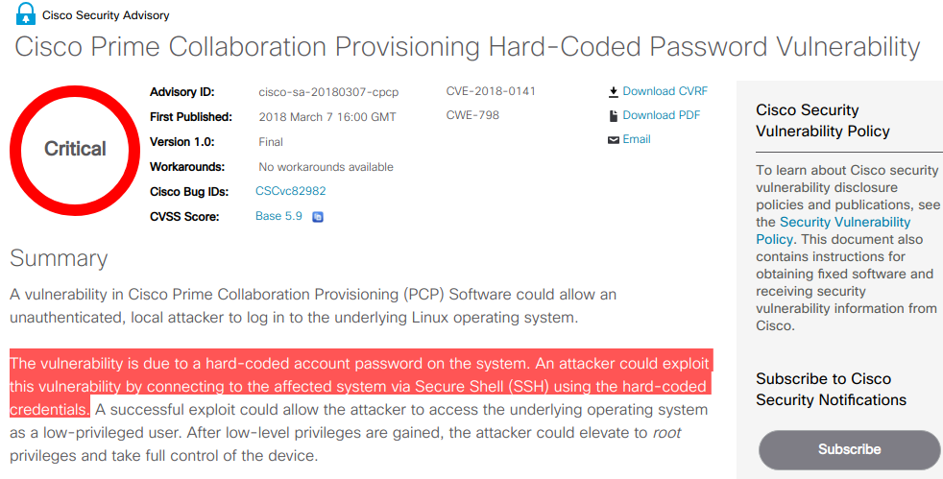
Hard coding Sensitive Information
Notes:
27/10/18

Slide 17
Security Tips
Copy with Caution
Say no to Defaults
Never hardcore
  Keys, Passwords
  Encryption or Hashing Scheme
  Bit sizes
Keys should never leave the box on which it was generated
Keys should encrypted as soon as it was generated
Follow the recommendations of “Crypto Review Board” of your organization.
  Ensure the most suitable and secure schemes are used.
  Update the scheme/bit size variables time to time

Slide 18
Security Tip : What Scheme to use when?
Cryptographic primitive / Security Goals | Hash | MAC | Digital signature
Integrity | Yes | Yes | Yes
Authentication | No | Yes | Yes
Non-repudiation | No | No | Yes
Kind of keys | None | Symmetric | Asymmetric
Notes:
27/10/18

Slide 19
3. Insecure coding
+ Hash Comparison
+ Branching/forking based on value of crypto resource
+ Processing sensitive data
+ Case Studies

Slide 20
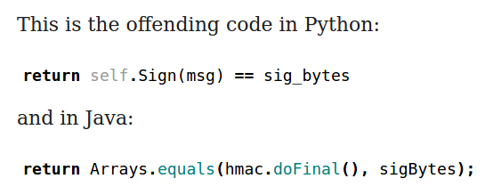
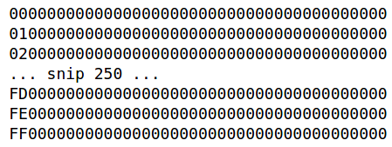
Side Channel Attack : Timing Attacks
200 ms
234 ms
195 ms
---
213 ms
205 ms
199 ms
450 ms
Source : A Lesson In Timing Attacks (or, Don’t use MessageDigest.isEquals) https://codahale.com/a-lesson-in-timing-attacks/
Timing Attacks
  Decisions
  Loops
  Branching
Notes:
27/10/18

Slide 21
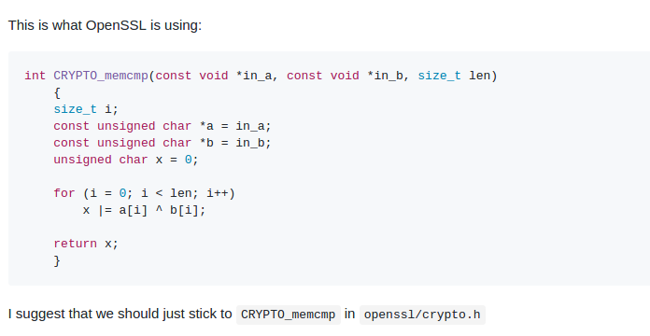
Time Safe Coding
Source : Crypto library should have a constant-time equality function https://github.com/nodejs/node-v0.x-archive/issues/8560
Notes:
27/10/18

Slide 22
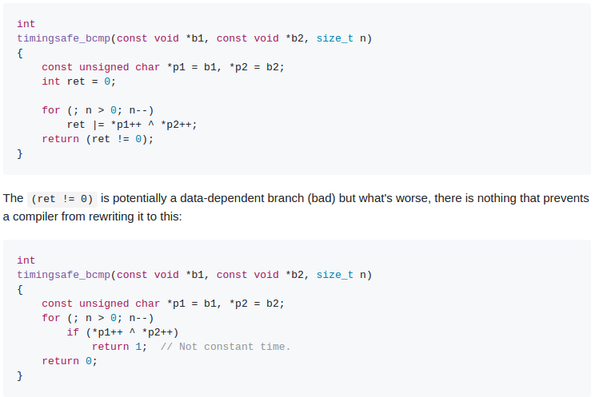
Compiler Optimization
Notes:
27/10/18

Slide 23
Stealing Sensitive Data in Process
Keys and Passwords if held in memory for longer than require then
  can be leaked through bugs
  dumped in to logs
  dumped in to core file
Case Study :
  Heart Bleed
  Ticket Bleed

Slide 24
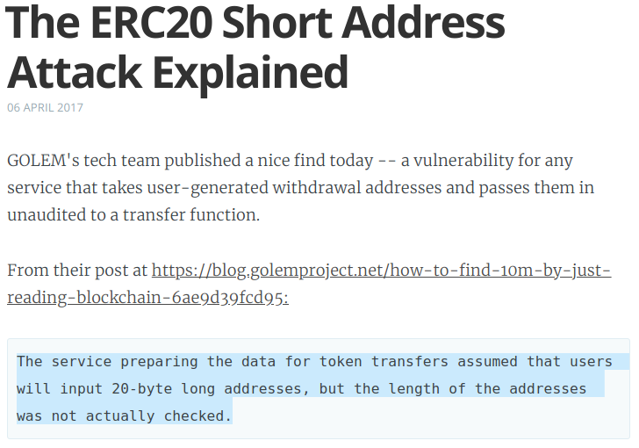
Length Extension Attack
Lab - LengthExt/lab-length-ext.txt

Slide 25
Security Tips
Use constant in time comparison/decision statement
Beware of compiler optimization
Clear the memory holding passwords or keys immediately after use
  Check out Androsia utility written by Samit Anwer presented & at AppSec USA 2017
  https://www.youtube.com/watch?v=cr8l_2f8boY

Slide 26
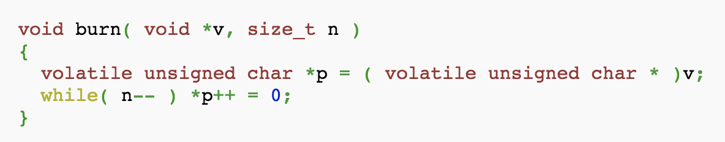
Security Tips
Wisely choose datatype to hold sensitive data
Java: use byte[]
Python3: use bytearray[]
Python2: use SecureString which has clearmem() method
Openssl : SecureZeroMemory() on win32, OPENSSL_cleanse() on Linux/BSD
C :
Hashes are Deterministic, use (Random) Salt to make them non-guessable/extendable

Slide 27
4. Parameter Reuse
+ Risk of Reusing Keys
+ Risk of using Nonce/Salt
+ Brain Wallet Attack

Slide 28
Reusing Keys
Reusing Private keys :
In Bitcoins, reusing keys leads to
  Lack of Privacy
  Makes transaction Quantum Unsafe
Reusing Public Keys :
Homework

Slide 29
Wallet Attack
Dictionary attack on Private key
Hash must always be ‘Salted’
Salt must be non-obvious
LAB : Generate wallets Public key, Private key from keybase.io
Tool : https://keybase.io/warp/

Slide 30
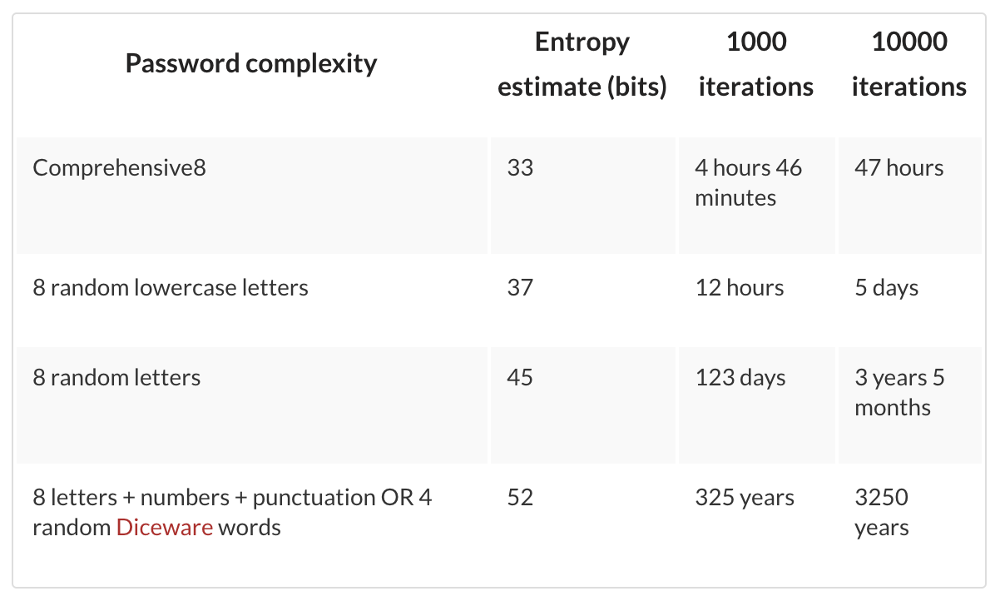
Password Based Key Derivation Function
Use PBKDF2 instead of PBKDF
How many Iterations are good enough?
https://cryptosense.com/parameter-choice-for-pbkdf2/

Slide 31
Other Parameter Reuse
What happens when parameters are reused over multiple crypto operations
+ Random values
+ DH Parameters
+ No Salts or Bad Salts

Slide 32
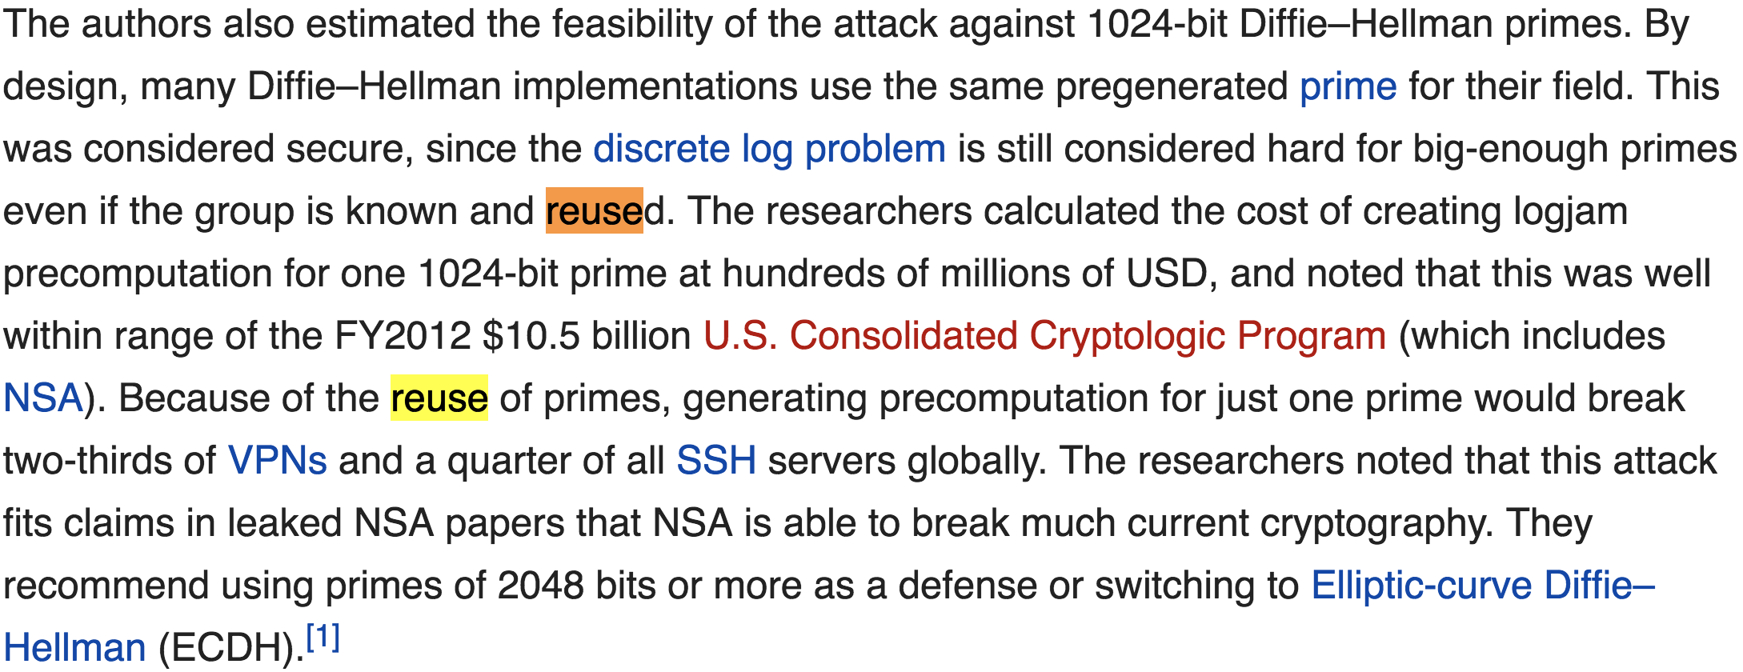
Reuse of Primes in DH parameters
LOGJAM Vulnerability (CVE-2015-4000)

Slide 33
Bitcoin Private Key recovery
ECDSA Signature scheme
Z = hash of content to be signed
R = Random String
K = ECDSA ephimeral key derived from R
S = Signature derived by encrypting (Z,R) with Private Key Pk
S = (Z + PkR)/K
Now we can sign 2 different blocks by same private key Pk
(s1,r1,z1) and (s2,r2,z2)
If the random string r1==r2 then we can derive the private key Pk by simply computing
Pk = (z1*s2 - z2*s1)/(r*(s1-s2))

Slide 34
Security Tips
Limit the exposer of Private Key
In Bitcoin/Blockchain based system don’t reuse private keys
Ensure Initialization Vector or Nonce are randomly generated and is not hard-coded and not reused
For schemes giving deterministic out put use salt
When you want to use salt, generate random salt & don’t reuse.

Slide 35
Conclusion
Cryptography is very powerful utility and very difficult to implement correctly.
Even if you user the most secure crypto primitives, if they are not used properly you don’t gain desired level of security
Handle sensitive data, keys, passwords, tokens, hashes etc carefully.
Cryptography standards change from time to time. Periodic reviews and updates are required

Slide 36
Thank you
AJIT HATTI
Founder – www.pureid.io
(ajit@pureid.io)

